Slide 1

Chapter 6 The List ADT

Slide 2
Chapter 6: The List ADT
6.1 – The List Interface
6.2 – List Implementations
6.3 – Applications: Card Deck and Games
6.4 – Sorted Array-Based List Implementation
6.5 – List Variations
6.6 – Application: Large Integers

Slide 3
6.1 – The List Interface
A list is a collection of elements, with a linear relationship existing among its elements.
Each element on the list has a position on the list, its index.
In addition to our lists supporting the standard collection operations add, get, contains, remove, isFull, isEmpty, and size, they support index-related operations and iteration.

Slide 4
Indexes
The elements of a list are indexed sequentially, from zero to one less than the size of the list
We define methods for adding, retrieving, changing, and removing an element at an indicated index, as well as a method for determining the index of an element.
Each method that accepts an index as an argument throws an exception (IndexOutOfBoundsException) if the index is invalid

Slide 5
For example
void add(int index, T element);
// Throws IndexOutOfBoundsException if passed an index argument
// such that index < 0 or index > size().
// Otherwise, adds element to this list at position index; all current
// elements at that position or higher have 1 added to their index.
// Optional. Throws UnsupportedOperationException if not supported.
T set(int index, T newElement);
// Throws IndexOutOfBoundsException if passed an index argument
// such that index < 0 or index >= size().
// Otherwise, replaces element on this list at position index with
// newElement and returns the replaced element.
// Optional. Throws UnsupportedOperationException if not supported.

Slide 6
Optional Operations
The add and set operations are optional.
These operations allow the client to insert an element into a list at a specified index and for some list implementations, notably a sorted list implementation, this could invalidate the internal representation of the list.
Our implementations will throw the Java library supplied UnsupportedOperationException in cases where an implementation does not support an operation.

Slide 7
Iteration
Our lists implement the library’s Iterable interface.
Iterable requires a single method, iterator, that creates and returns an Iterator object.
Methods that create and return objects are sometimes called Factory methods.
Iterator objects provide three operations: hasNext, next, and remove.

Slide 8
Example use of an Iterator
Suppose strings is a List ADT object that contains the four strings “alpha,” “gamma,” “beta,” and “delta.” The following code would delete “gamma”
from the list and display the other three strings.
Iterator<String> iter = strings.iterator();
String hold;
while (iter.hasNext())
{
hold = iter.next();
if (hold.equals("gamma"))
iter.remove();
else
System.out.println(hold);
}

Slide 9
ListInterface (comments removed)
package ch06.lists;
import java.util.*;
import ch05.collections.CollectionInterface;
public interface ListInterface<T> extends CollectionInterface<T>,
Iterable<T>
{
void add(int index, T element);
T set(int index, T newElement);
T get(int index);
int indexOf(T target);
T remove(int index);
}

Slide 10
6.2 List Implementations
In this section we develop an array-based and a link-based implementation of the List ADT.
Because a list is a collection the mplementations share some design and code with their Collection ADT counterparts.
Here we emphasize the new functionality—the indexing and the iteration

Slide 11
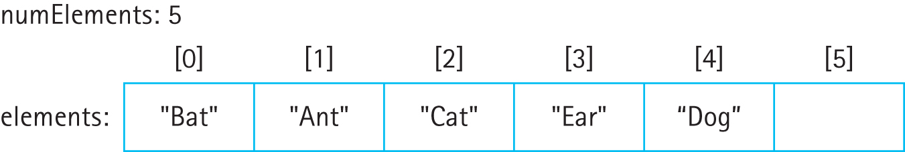
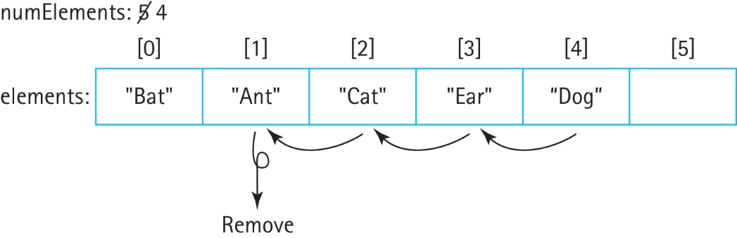
Array-Based Implementation
Same approach for our array-based list:
… except must maintain index “order” of elements during operations:

Slide 12
Index Related Operations
The methods each follow the same pattern:
check the index argument
if it is outside the allowable range for that operation throw an exception
otherwise carry out the operation.
Because of the close logical relationship between the internal representation, an array, and the ADT, an indexed list, the implementation of these operations is very straightforward.

Slide 13
For example, the set method
public T set(int index, T newElement)
// Throws IndexOutOfBoundsException if passed an index argument
// such that index < 0 or index >= size().
// Otherwise, replaces element on this list at position index with
// newElement and returns the replaced element.
{
if ((index < 0) || (index >= size()))
throw new IndexOutOfBoundsException("Illegal index of " + index +
" passed to ABList set method.\n");
T hold = elements[index];
elements[index] = newElement;
return hold;
}

Slide 14
Iteration
We use an anonymous inner class approach
Anonymous class has no name .. it is just instantiated where needed
The behavior of an iterator is unspecified if the underlying representation is modified while the iteration is in progress in any way other than by calling the iterator’s remove method

Slide 15
public Iterator<T> iterator()
{
return new Iterator<T>()
{
private int previousPos = -1;
public boolean hasNext()
{
return (previousPos < (size() - 1)) ;
}
public T next()
{
if (!hasNext())
throw new IndexOutOfBoundsException("Illegal invocation of next " +
" in LBList iterator.\n");
previousPos++;
return elements[previousPos];
}
public void remove()
{
for (int i = previousPos; i <= numElements - 2; i++)
elements [i] = elements[i+1];
elements [numElements - 1] = null;
numElements--;
previousPos--;
}
};
}

Slide 16
Link-Based Implementation
Some of the link-based collection implementation design and code can be reused for the link-based list.
To support the add method, which adds elements to the end of the list, we maintain a new reference rear to the end of the list.
To support the indexOf method we include a new targetIndex variable, which the find method sets, in addition to setting found, location, and previous.

Slide 17
Example Index Related Operation
public T set(int index, T newElement
// Throws IndexOutOfBoundsException if passed an index argument
// such that index < 0 or index >= size().
// Otherwise, replaces element on this list at position index with
// newElement and returns the replaced element.
{
if ((index < 0) || (index >= size()))
throw new IndexOutOfBoundsException("Illegal index of " + index +
" passed to LBList set method.\n");
LLNode<T> node = front;
for (int i = 0; i < index; i++)
node = node.getLink();
T hold = node.getInfo();
node.setInfo(newElement);
return hold;
}

Slide 18
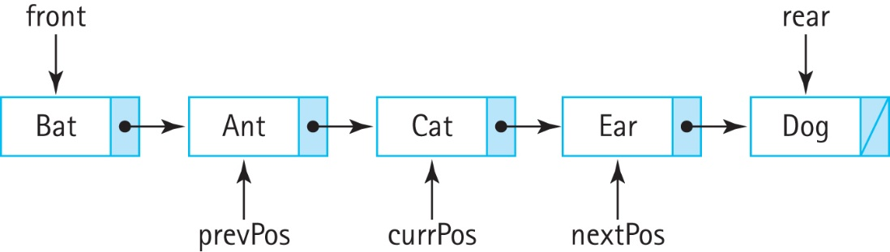
Iteration
Again use an anonymous inner class within the iterator method.
The instantiated Iterator object keeps track of three instance variables to provide the iteration and to support the required remove operation:
The next method returns the element referenced by nextPos and updates the three references

Slide 19
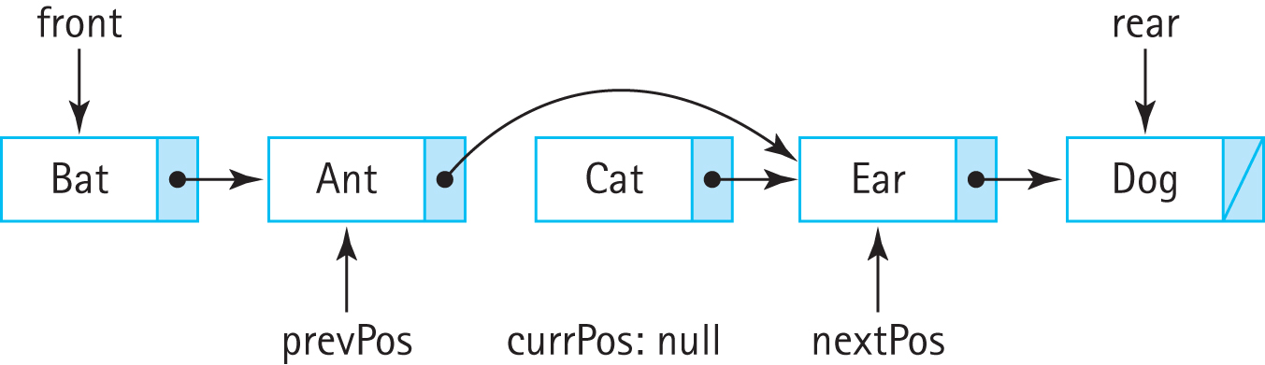
Iteration
If remove invoked in the middle of an iteration it removes the element that was just returned, the element referenced by currPos:

Slide 20
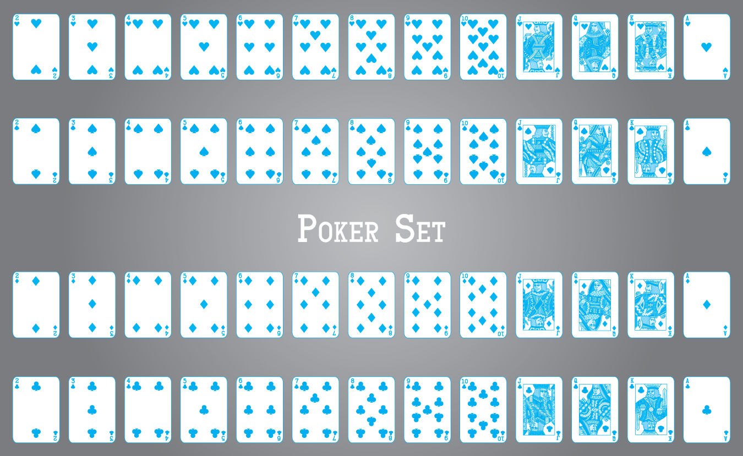
6.3 Applications: Card Deck and Games

Slide 21
The Card class
Found in the support.cards package
A card object has three attributes:
rank: the rank of the card e.g. Five or King
suit: the suit of the card e.g. Heart or Spade
image: an image icon associated with the card
rank and suit are both represented by public enum classes provided by the Card class
The image files used for the image icons are also located in the support.cards package
Attribute getter methods are provided plus an equals, a compareTo and a toString

Slide 22
The CardDeck class
Uses an ABList of Card objects named deck as its internal representation
Another instance variable, deal, which holds an Iterator<Card> object, is used to deal cards
deal is set to deck.iterator()
Exports methods for shuffling the deck and iterating through the deck

Slide 23
Applications
CardHandCLI – command line interface program which deals a 5 card hand from a card deck, allowing the user to arrange the cards
CardHandGUI – graphical user interface program which deals a 5 card hand from a card deck, allowing the user to arrange the cards
HigherLower – Predict whether the next card will be higher or lower
Pairs – Analyzes the probability of being dealt a pair in a 5 card hand

Slide 24
6.4 Sorted Array-Based List Implementation
Class SortedABList implements ListInterface and is found in the ch06.lists package
Much of the design and code of the SortedArrayCollection from the ch05.collections package can be reused.
We state as a general precondition of the class that the index-based add and set operations are not supported.

Slide 25
Code for the two unsupported methods
public void add(int index, T element)
// Throws UnsupportedOperationException.
{
throw new UnsupportedOperationException("Unsupported index-based add …
}
public T set(int index, T newElement)
// Throws UnsupportedOperationException.
{
throw new UnsupportedOperationException("Unsupported index-based set …
}

Slide 26
Comparator Interface
We want to allow clients of our SortedABList to be able to specify for themselves how the elements should be sorted
The Java Comparator interface defines two abstract methods:
Using an approach based on the Comparator class allows for multiple sorting orders
public abstract int compare(T o1, T o2);
// Returns a negative integer, zero, or a positive integer to indicate that
// o1 is less than, equal to, or greater than o2
public abstract boolean equals(Object obj);
// Returns true if this Comparator equals obj; otherwise, false

Slide 27
Comparator Interface
Using an approach based on the Comparator class allows for multiple sorting orders
For example our FamousPerson class typically bases comparison on last name, first name but it could also define other approaches:
public static Comparator<FamousPerson> yearOfBirthComparator()
{
return new Comparator<FamousPerson>()
{
public int compare(FamousPerson element1, FamousPerson element2)
{
return (element1.yearOfBirth - element2.yearOfBirth);
}
};
}

Slide 28
SortedABList Constructors
There are two constructors
One uses the “natural order” of the elements
The other uses an order provided by the client who passes an appropriate Comparator object as an argument to the method
A private variable comp of class Comparator<T> is used to make comparisons internally and is set by the invoked constructor

Slide 29
SortedABList Constructors
protected Comparator<T> comp;
public SortedABList()
// Precondition: T implements Comparable
{
list = (T[]) new Object[DEFCAP];
comp = new Comparator<T>()
{
public int compare(T element1, T element2)
{
return ((Comparable)element1).compareTo(element2);
}
};
}
public SortedABList(Comparator<T> comp)
{
list = (T[]) new Object[DEFCAP];
this.comp = comp;
}
See the CSPeople application in the
ch06.apps package for an example
demonstrating the use of these two
constructors.

Slide 30
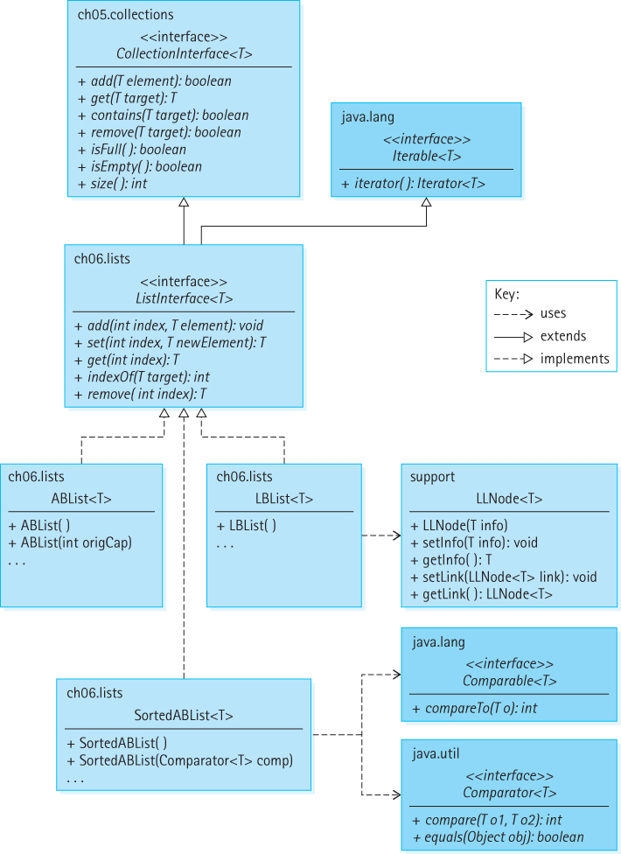
Our List ADT Architecture

Slide 31
6.5 List Variations
Java Library
The library provides a List interface that inherits from both the Collection and Iterable interfaces of the library.
The library’s list interface is significantly more complex than ours, defining 28 abstract methods.
It is implemented by the following classes: AbstractList, AbstractSequentialList, ArrayList, AttributeList, CopyOnWriteArrayList, LinkedList, RoleList, RoleUnresolvedList, Stack, and Vector.

Slide 32
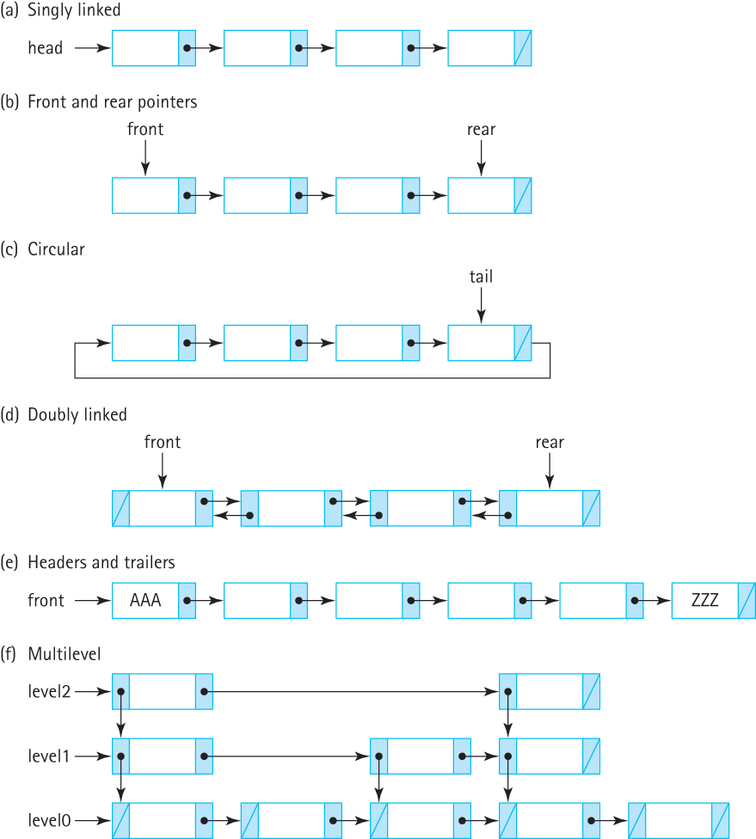
Linked List Variations

Slide 33
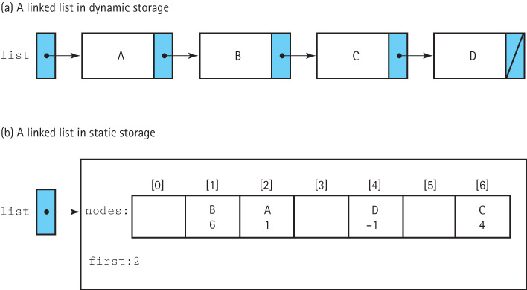
A Linked List as an Array of Nodes

Slide 34
Why Use an Array?
Sometimes managing the free space ourselves gives us greater flexibility
There are programming languages that do not support dynamic allocation or reference types
There are times when dynamic allocation of each node, one at a time, is too costly in terms of time

Slide 35
Boundedness
A desire for static allocation is one of the primary motivations for the array-based linked approach
We drop our assumption that our lists are of unlimited size in this section - our lists will not grow as needed.
Applications should not add elements to a full list.

Slide 36
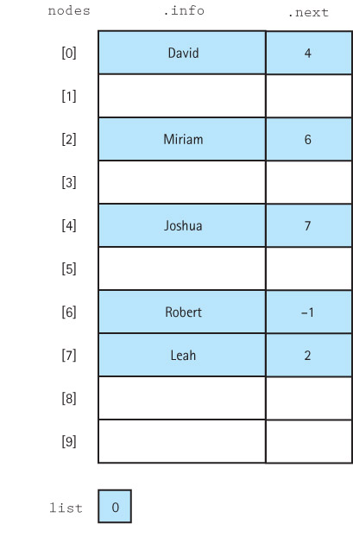
A sorted list

Slide 37
Implementation Issues
We mark the end of the list with a “null” value
the “null” value must be an invalid address for a real list element
we use the value –1
we suggest using the identifier NUL and defining it to be -1
private static final int NUL = –1;
One must directly manage the free space available for new list elements.
Link the collection of unused array elements together into a linked list of free nodes.
Write your own method to allocate nodes from the free space. We suggest calling this method getNode.
Write your own method, we suggest calling it freeNode, to put a node back into the pool of free space when it is de-allocated.

Slide 38
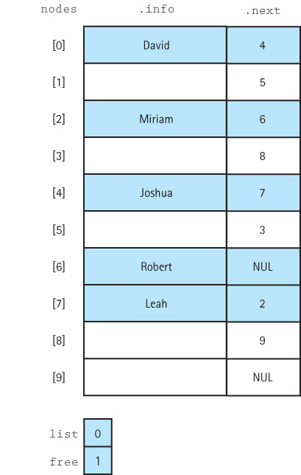
A linked list and free space

Slide 39
6.6 Application: Large Integers
The largest Java integer type, long, can represent values between −9,223,372,036,854,775,808 and 9,223,372,036,854,775,807
Believe it or not, for some applications that may not be sufficient
A linked list of digits can grow to be any size, and thus can be used to represent integers of any size

Slide 40
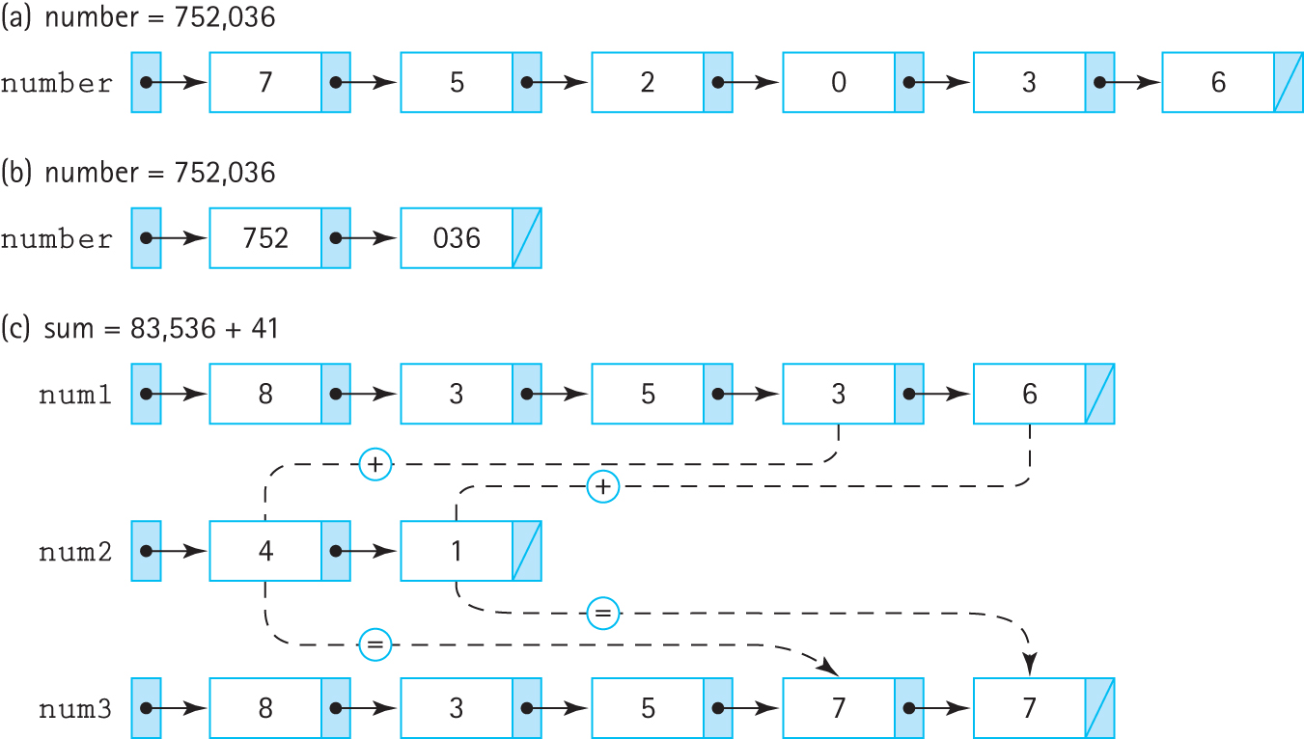
Representing large integers with linked lists

Slide 41
The LargeInt class
Constructors – one that creates an “empty” integer and one that creates an integer based on a String argument
setNegative – makes the large integer negative
toString – returns string representation
add – returns the sum of two large integers
subtract – returns the difference of two large integers
To support the creation and arithmetic manipulation of large integers we define a special list class …

Slide 42
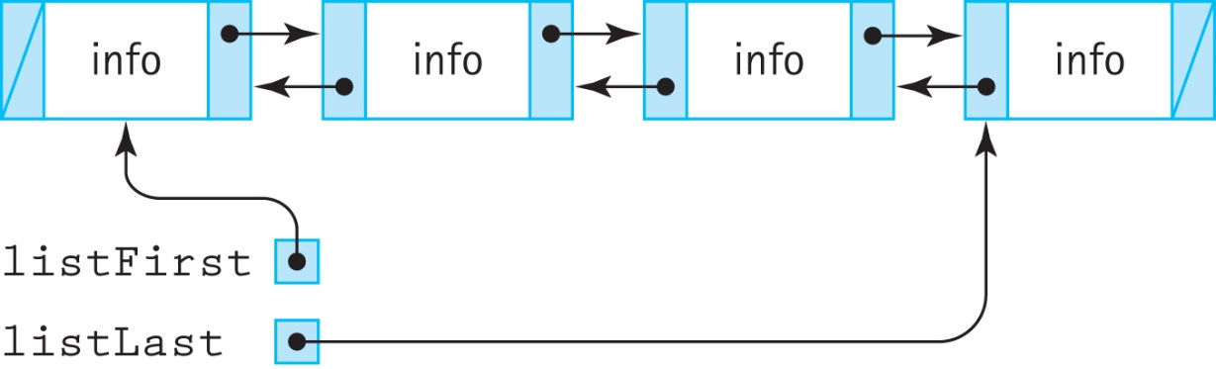
The LargeIntList class
a list of byte (to hold digits)
provide operations size, addFront, addEnd, and both forward and reverse iterators
To support these requirements we use a reference-based doubly linked structure

Slide 43
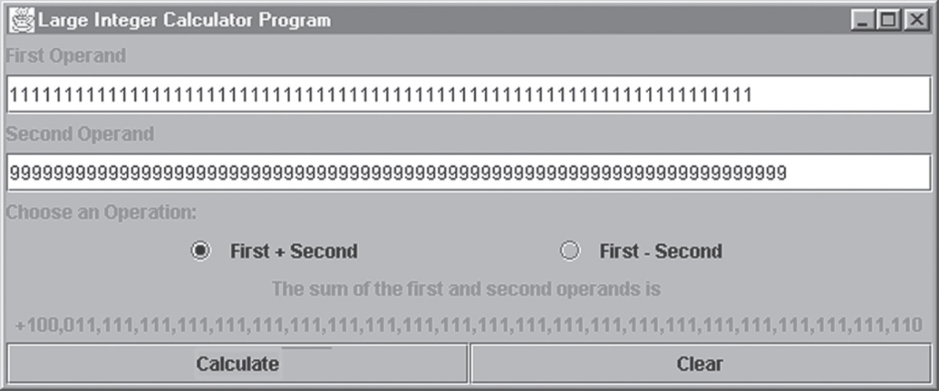
Applications
LargeIntCLI - in the ch06.apps package, allows the user to enter two large integers, performs the addition and subtraction of the two integers, and reports the results.
LargeIntGUI - in the ch06.apps package:

Slide 44
Code and Demo
Instructors can now review the algorithms, walk through the code for the classes, and demonstrate the running applications.

Slide 45
Important Concept Revisited: Abstraction Hierarchy
Here we saw another example of an abstraction hierarchy.
Applications use the LargeInt class, which uses the LargeIntList class, which uses the DLLNode class.
When working at any level in this hierarchy as a programmer we need to know only how to use the next lower level – we do not need to know how it is implemented nor need we worry about the details of lower levels.
Abstraction is indeed the key to conquering complexity.

